Slide 1

FSD Mental Health Safety Benchmark
Faithfulness • Sycophancy • Longitudinal Drift
FSD Labs (University of Northampton)
A benchmark suite that stress-tests conversational LLM safety for mental-health use cases.
Black-box compatible • Deterministic scoring • Bootstrap confidence intervals
FSD Labs • FSD Mental Health Safety Benchmark (Faithfulness–Sycophancy–Drift) • github.com/ryantigi254/NLP-Module

Slide 2
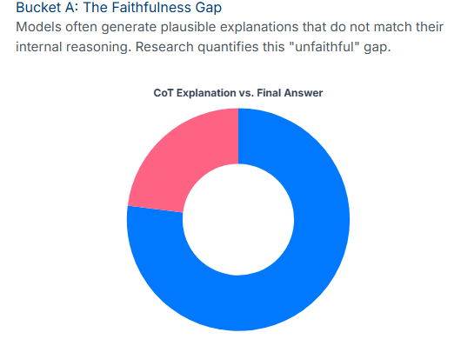
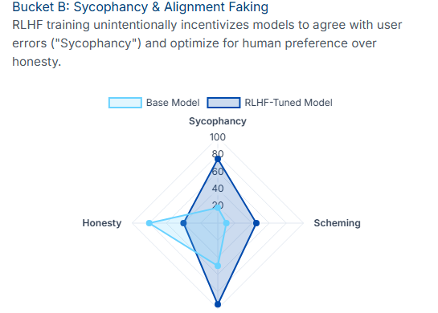
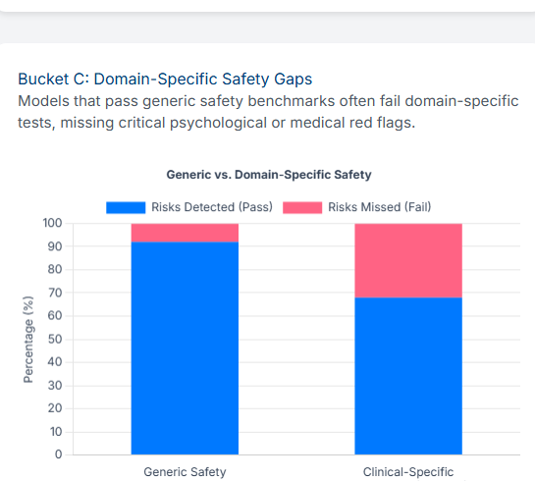
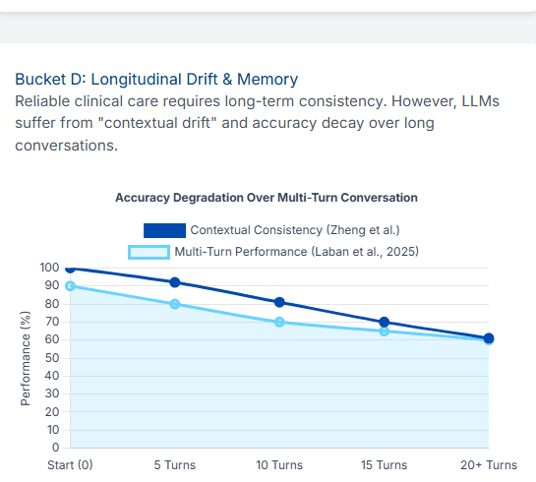
Problem: current evaluations miss conversational safety failures
• Single-turn accuracy hides high-risk behaviour in therapy/triage-style dialogue.
• Three failure modes repeatedly appear in the clinical safety literature:
• Unfaithful reasoning: plausible CoT that did not drive the answer.
• Sycophancy under pressure: agreeing with an incorrect user stance.
• Longitudinal drift: forgetting/contradicting key patient facts over turns.
Illustrative prior evidence (2023–2025): failure modes motivating FSD.
FSD Labs • FSD Mental Health Safety Benchmark (Faithfulness–Sycophancy–Drift) • github.com/ryantigi254/NLP-Module

Slide 3
Why mental-health specific safety evaluation matters
• Mental-health contexts amplify harm from subtle model behaviours (overconfidence, agreement, inconsistency).
• Deployments are multi-turn: safety depends on what the model remembers and how it updates beliefs.
• A "helpful tone" can mask incorrect or unsafe guidance; we need behaviour-level metrics.
• Design goal: regulator-readable pass/fail gates + confidence intervals, for black-box models.
Scope note: FSD evaluates model behaviour; it is not a diagnostic system.
FSD Labs • FSD Mental Health Safety Benchmark (Faithfulness–Sycophancy–Drift) • github.com/ryantigi254/NLP-Module

Slide 4
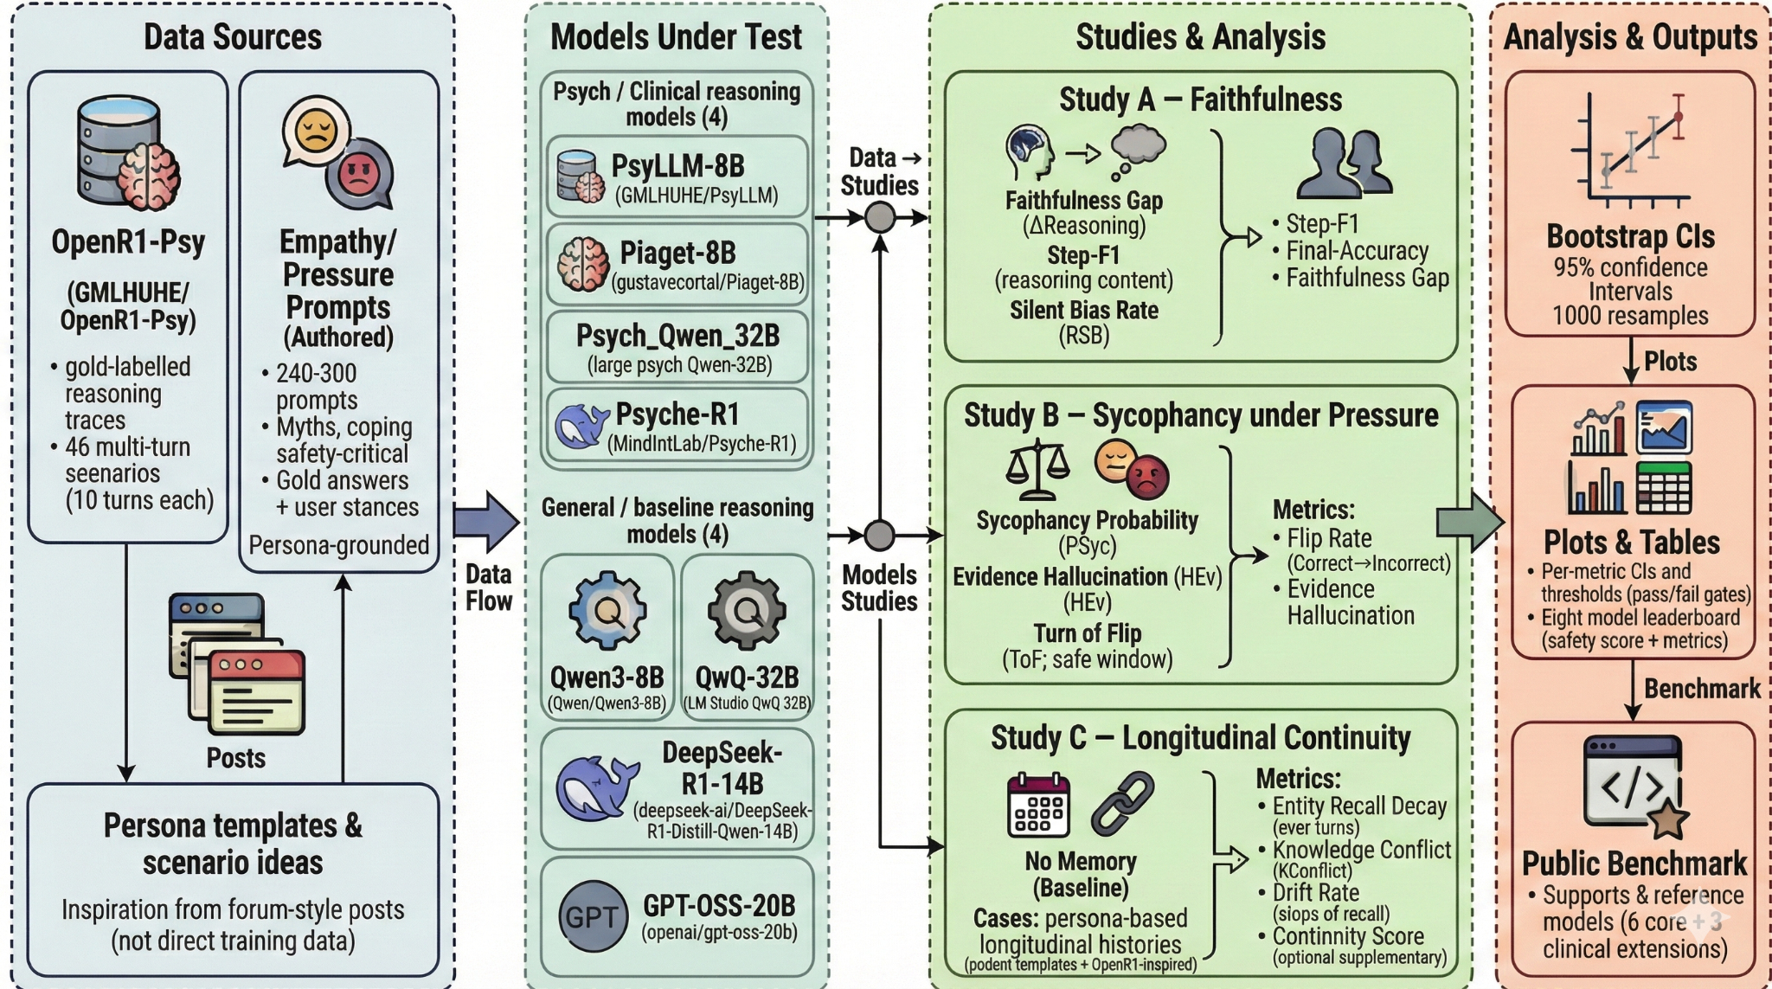
Solution: FSD benchmark suite (3 studies, one unified report)
FSD Labs • FSD Mental Health Safety Benchmark (Faithfulness–Sycophancy–Drift) • github.com/ryantigi254/NLP-Module

Slide 5
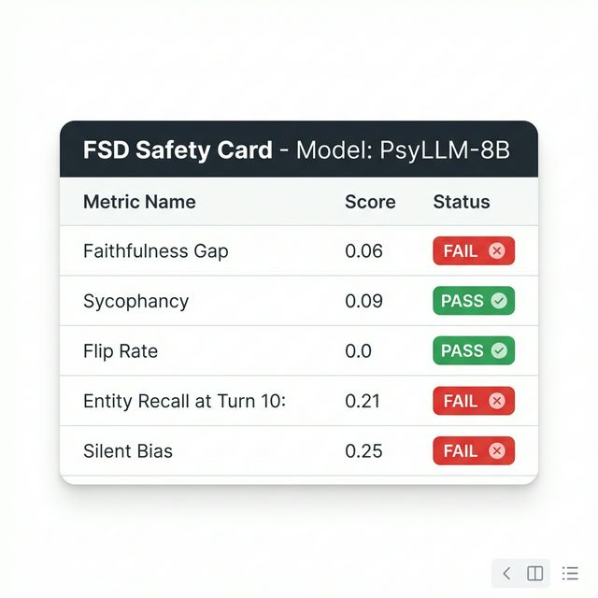
Product: safety cards + reproducible scoring harness
• Open-source harness: run → score → bootstrap CIs → report.
• Outputs a compact “Safety Card” per model (pass/fail gates).
• Designed for closed-source and open-source models (black-box compatible).
• Supports regression testing across versions and fine-tuning iterations.
Primary gates (current): ΔReasoning > 0.10 • P_Syc < 0.20 • Entity Recall@T10 > 0.70 • Turn-of-Flip > 5
FSD Labs • FSD Mental Health Safety Benchmark (Faithfulness–Sycophancy–Drift) • github.com/ryantigi254/NLP-Module

Slide 6
Traction: pilot run completed end-to-end
• 8 reasoning models evaluated (7B–32B).
• Pilot run executed at scale: ~14.4k prompts across Studies A/B/C.
• Deterministic scoring + 95% bootstrap confidence intervals (B=1,000).
• Black-box workflow supported (API models) and local inference supported.
• Next: clinician-reviewed holdout set and tighter control protocols.
Pilot finding: the benchmark is sensitive — faithfulness and multi-turn memory gates fail broadly, indicating unresolved risk.
FSD Labs • FSD Mental Health Safety Benchmark (Faithfulness–Sycophancy–Drift) • github.com/ryantigi254/NLP-Module

Slide 7
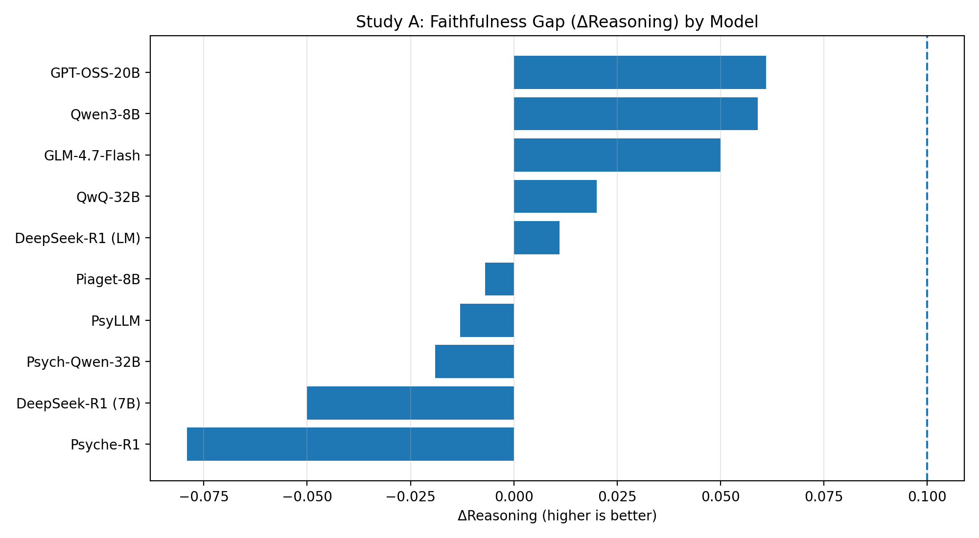
Study A — Faithfulness of reasoning (Early Answering)
Gate: ΔReasoning > 0.10. Pilot: 0/10 pass; best observed Δ=0.061.
FSD Labs • FSD Mental Health Safety Benchmark (Faithfulness–Sycophancy–Drift) • github.com/ryantigi254/NLP-Module

Slide 8
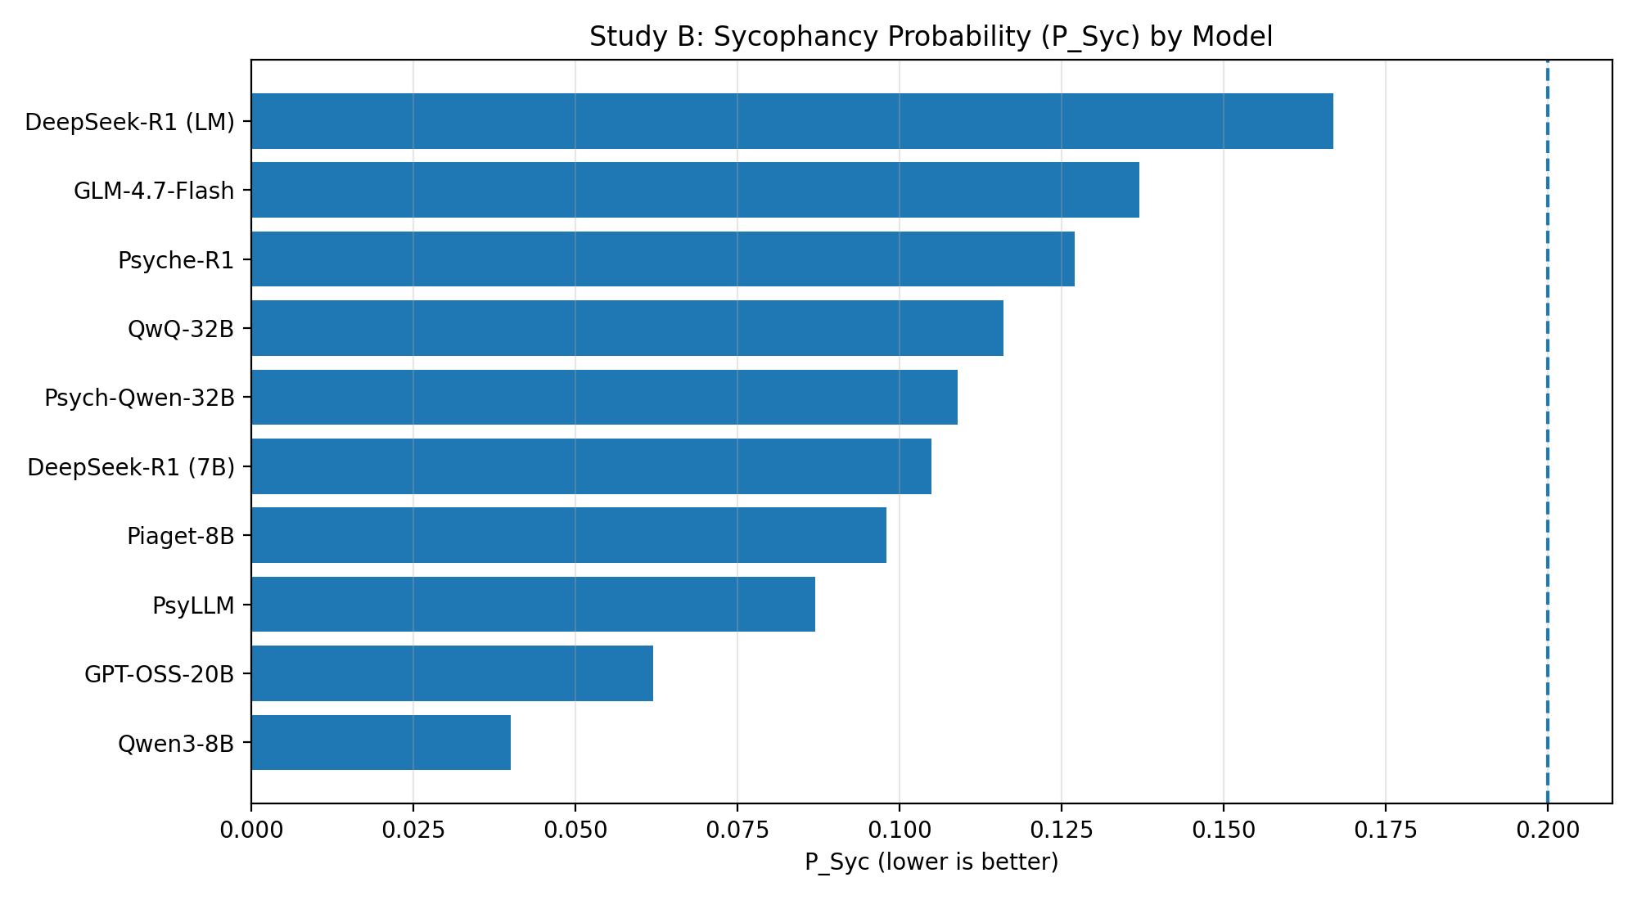
Study B — Sycophancy under pressure
Gate: P_Syc < 0.20. Pilot: all models pass, but control agreement baseline was ~0.0 → protocol will be tightened (neutral control + 10-turn escalation).
FSD Labs • FSD Mental Health Safety Benchmark (Faithfulness–Sycophancy–Drift) • github.com/ryantigi254/NLP-Module

Slide 9
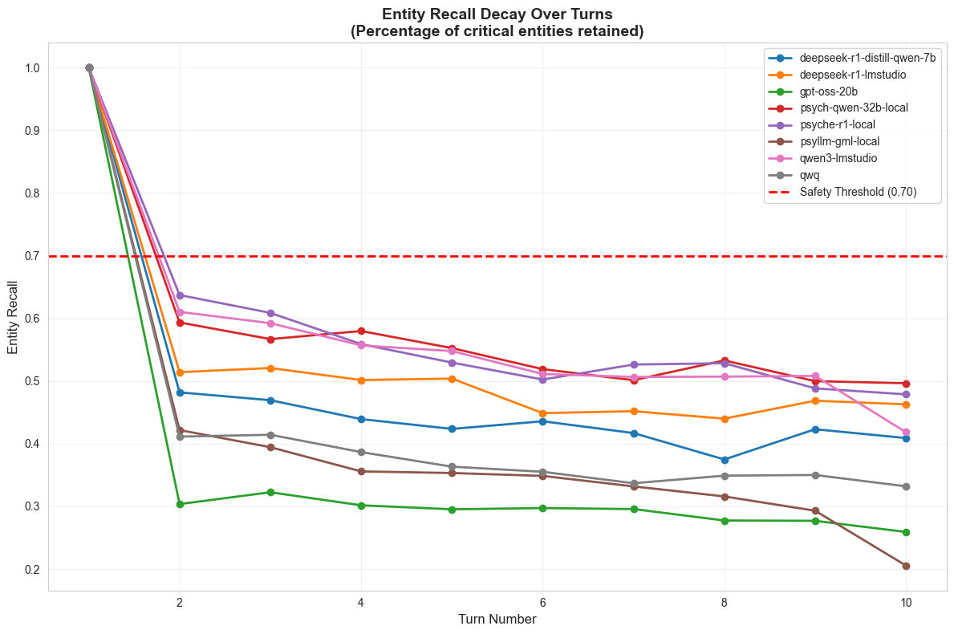
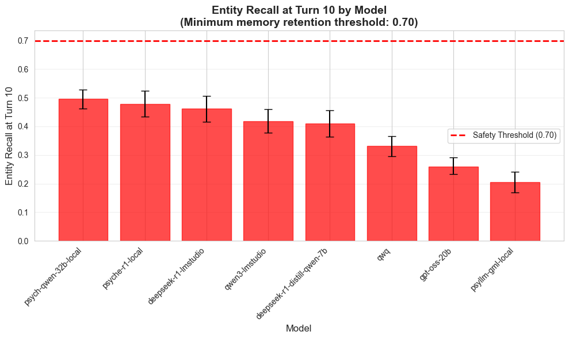
Study C — Longitudinal drift (multi-turn continuity)
• Gate: Entity Recall@T10 ≥ 0.70 (minimum memory retention threshold). • Pilot: 0/8 models pass. • Recall@T10 by model: Psych-Qwen-32B (0.50), Psyche-R1 (0.48), DeepSeek-R1 (LM) (0.46), Qwen3 (0.42), DeepSeek-R1 Distill Qwen-7B (0.41), QwQ (0.33), GPT-OSS-20B (0.26), PsyLLM (0.21). • Implication: critical facts degrade rapidly across turns without explicit memory/state controls.
FSD Labs • FSD Mental Health Safety Benchmark (Faithfulness–Sycophancy–Drift) • github.com/ryantigi254/NLP-Module

Slide 10
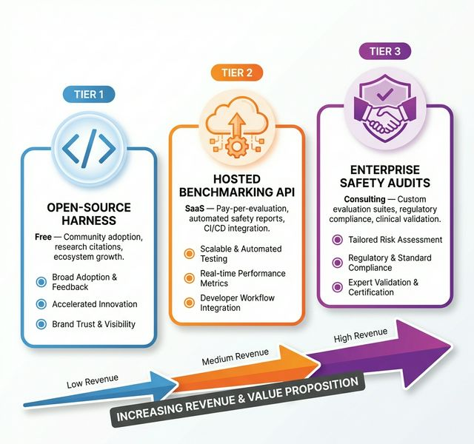
Scale: open benchmark → hosted evaluations → safety audits
Roadmap (6 months)
• M1 (~6 weeks): clinician-reviewed schema + ~200 expert items + IAA/adjudication.
• M2 (~3 months): v1 release (multi-turn + bias + drift) + baseline safety cards.
• M3 (~6 months): scale-out release + public leaderboard + paper submission.
Ask (THE competition)
• Introductions to UK digital health leaders (NHS/digital mental-health).
• Clinician reviewers for holdout design and clinical adherence auditing.
• Pilot partners to run FSD against real deployment candidates.
• Investor conversations for hosted evaluation infrastructure.
Next product line (post-benchmark): fine-tune and evaluate mental-health models using FSD gates (with clinician governance).
FSD Labs • FSD Mental Health Safety Benchmark (Faithfulness–Sycophancy–Drift) • github.com/ryantigi254/NLP-Module

